Slide 1
MONEY MATTERS:PERSONAL FINANCE MANAGEMENT APP
One of the main factors hindering possible resolutions of family debt is the lack of key financial literacy skills that currently pertain in most low-skilled communities where debt burdens remain high.
S.NO | NAMES | NAAN MUDHALVAN ID
1 | K.BALAJI | 126176715ABAC238993492271106508C
2 | K.RAGUL | 93A1B8D9BF127D8AF6F49D8AA086C5BC
3 | V.VELMANI | E1F56622184546BAE364F6A3C162486B
4 | E.DHANUSH | 54C9552342AF876905649F6F56A29AA5
5 | G.PRASANNA | 38493E78D365DD0AEAA4A7606858FB43

Slide 2

Money Matters
Money matters are essential for navigating the complexities of modern life. This presentation explores key financial concepts, providing you with the tools and knowledge to make informed decisions about your finances.

Slide 3

Why Financial Literacy Matters
1
Informed Decisions
2
Financial Security
3
Avoid Scams
Financial literacy empowers you to make smart choices about spending, saving, and investing.
Understanding financial concepts helps build a strong financial foundation for the future.
Knowledge protects you from fraudulent activities and schemes that target unsuspecting individuals.

Slide 4
Budgeting 101: Tips for Saving and Spending Wisely
Track Your Spending
Set Financial Goals
Prioritize Needs vs. Wants
Use a budgeting app or spreadsheet to monitor your income and expenses.
Establish clear goals, such as saving for a down payment or paying off debt.
Distinguish between essential expenses and discretionary spending.

Slide 5

Understanding Credit: Building and Maintaining a Healthy Credit Score
1
Establish Credit
Open a credit card and make timely payments to build your history.
2
Use Credit Wisely
Keep credit utilization low by avoiding excessive borrowing.
3
Monitor Your Score
Regularly check your credit report and dispute any errors.

Slide 6

Investing for the Future: Retirement Planning and Wealth Building
Retirement Accounts
Diversification
Long-Term Perspective
Explore options like 401(k)s and IRAs for tax-advantaged savings.
Spread investments across different asset classes to reduce risk.
Invest for the long haul, weathering market fluctuations.

Slide 7

Navigating Taxes: Strategies for Filing and Maximizing Deductions
Strategy
Description
Standard Deduction
A fixed amount you can deduct from your taxable income.
Itemized Deductions
Specific expenses you can deduct, such as medical expenses or mortgage interest.

Slide 8




Emergency Funds and Unexpected Expenses: Preparing for the Unexpected
Build a Fund
Save a minimum of 3-6 months of living expenses.
Identify Potential Risks
Consider car repairs, medical bills, and job loss.
Create a Plan
Outline steps to manage unexpected expenses.

Slide 9
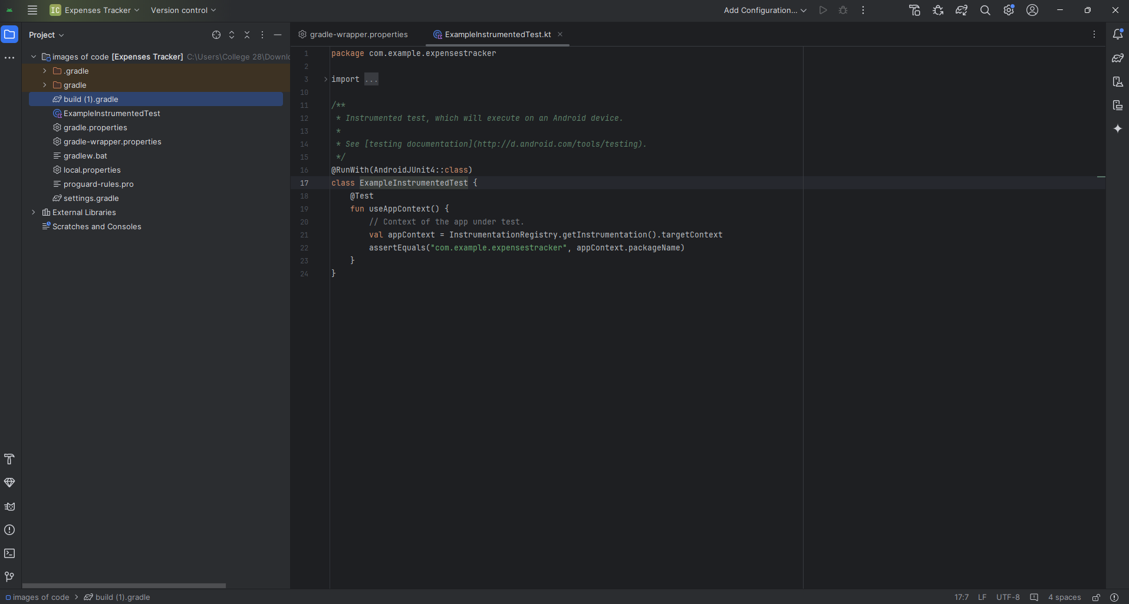

Slide 10
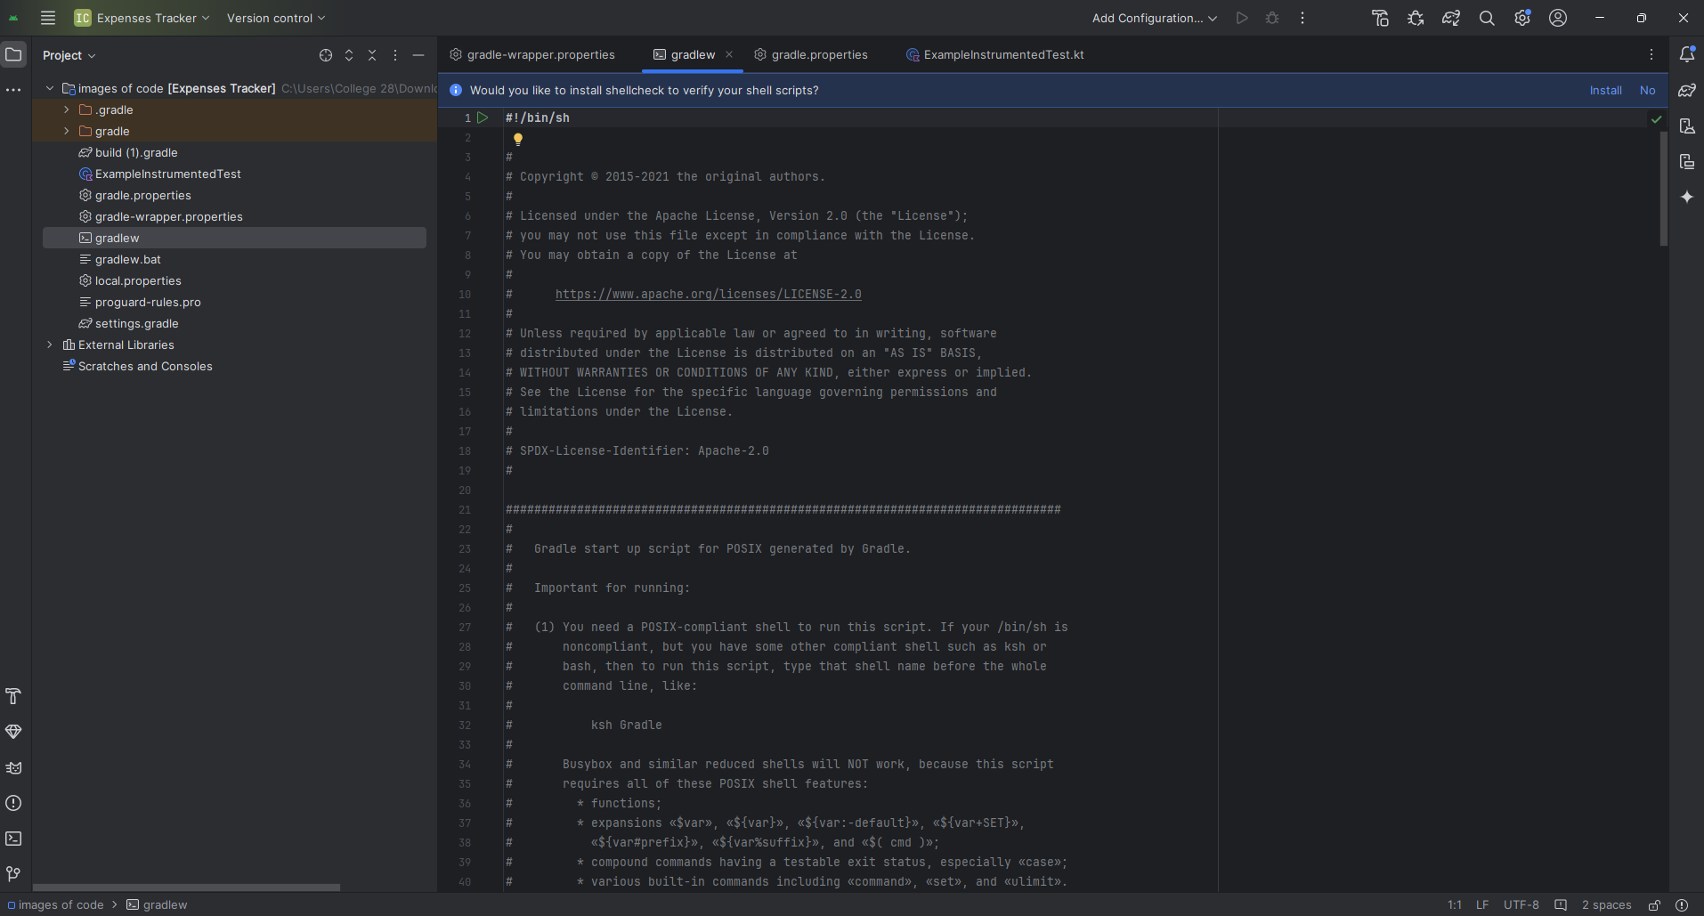

Slide 11
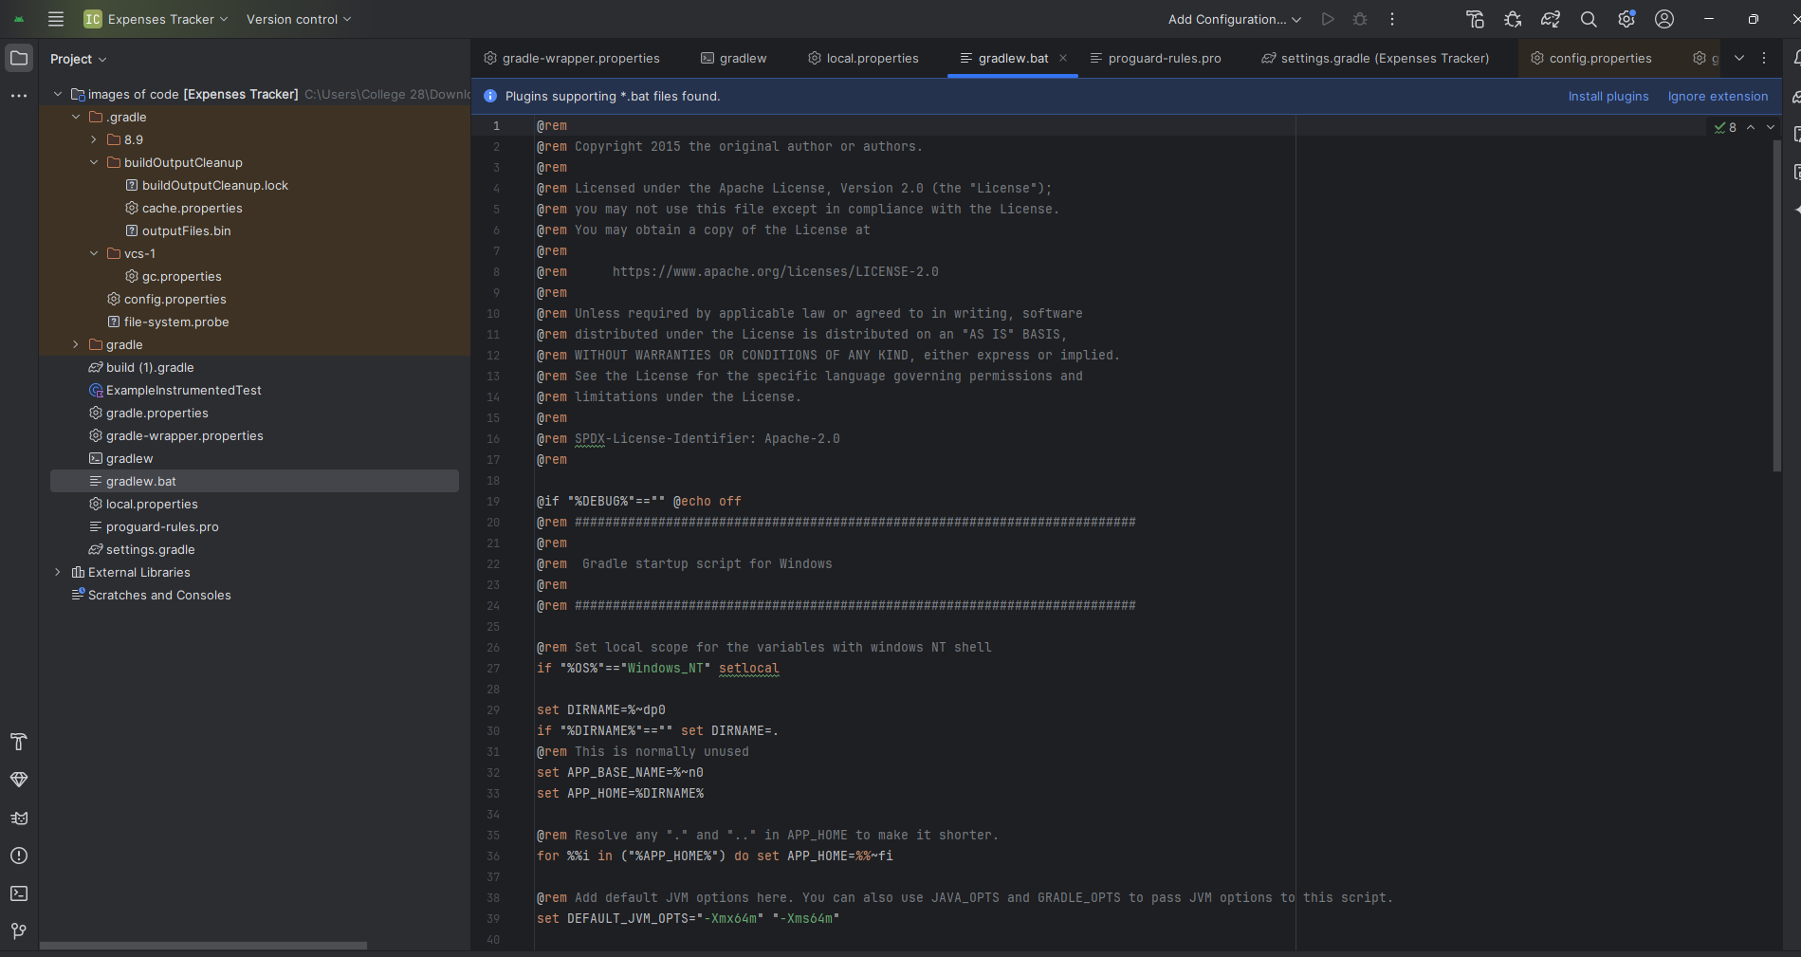

Slide 12
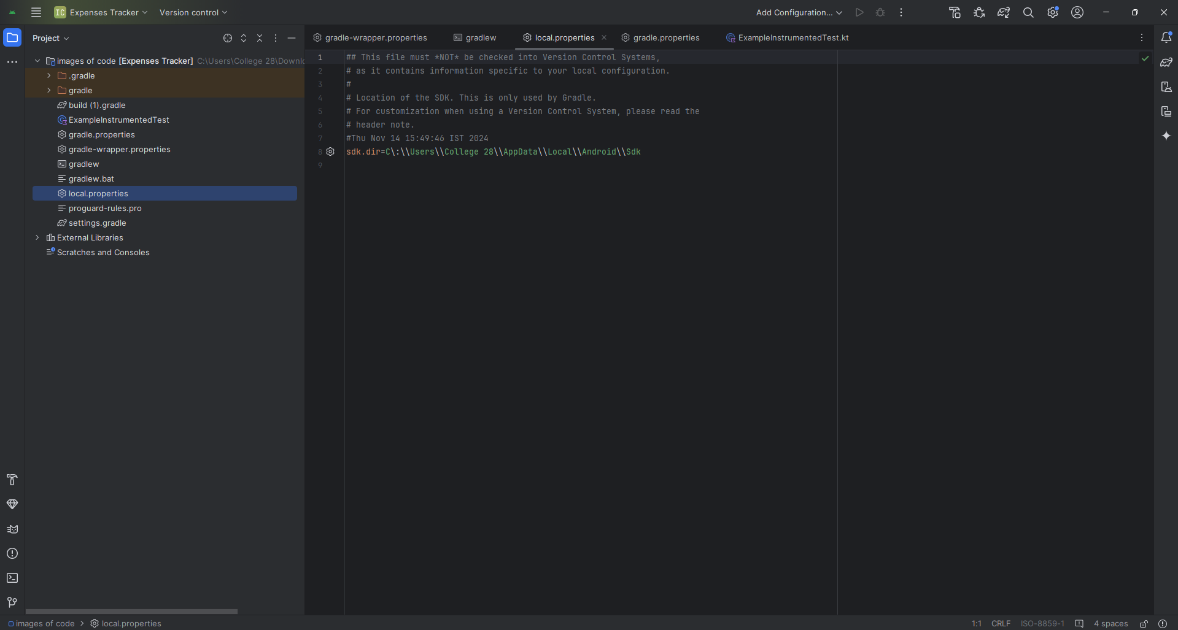

Slide 13
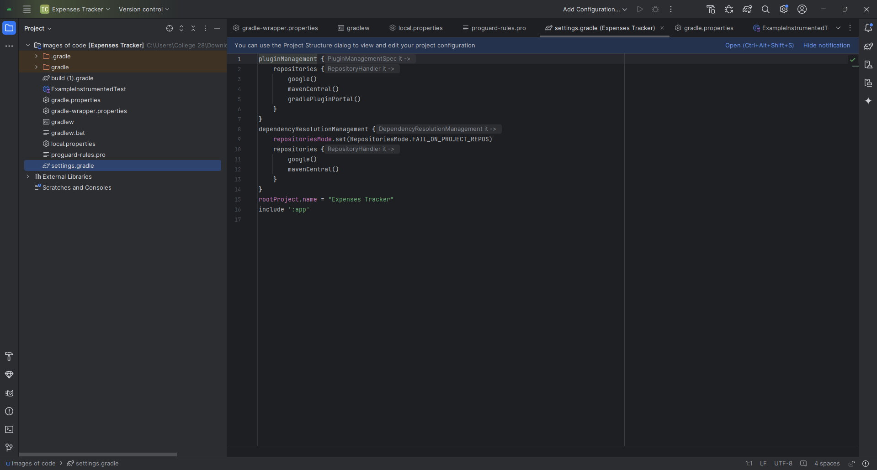

Slide 14
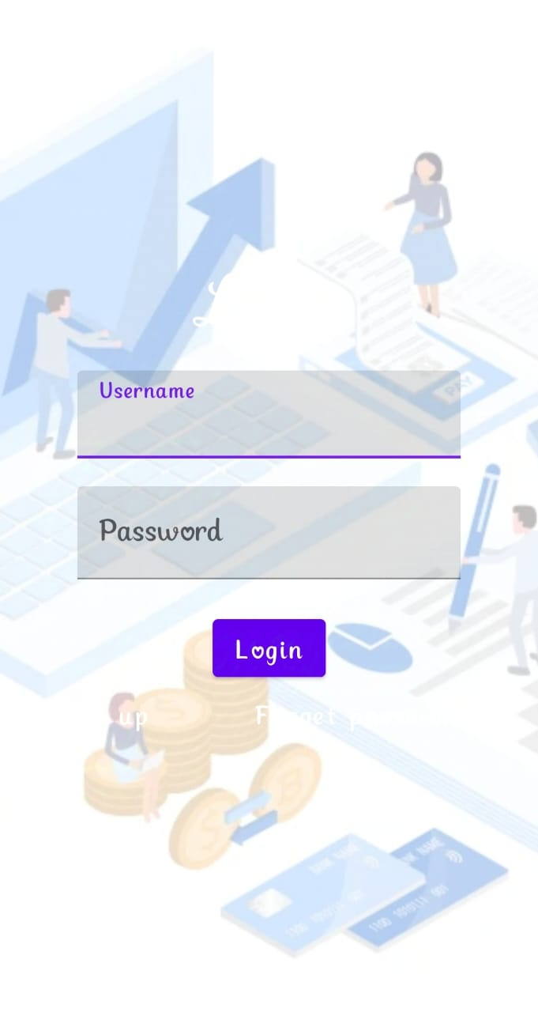
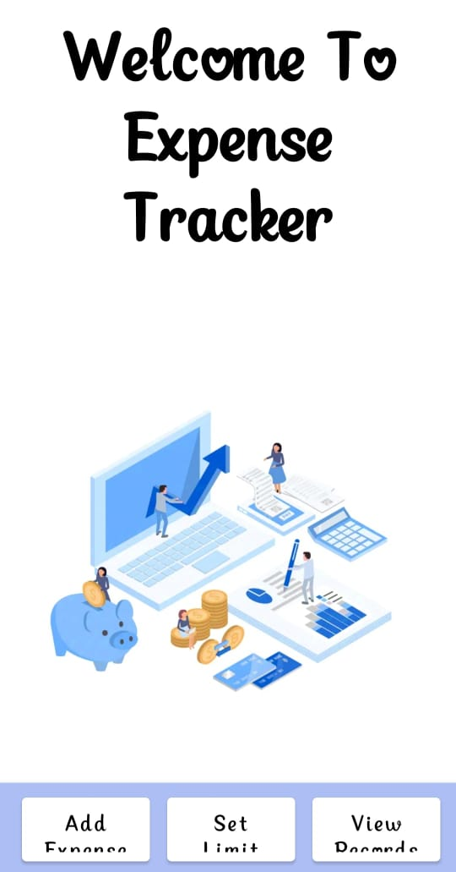
Step:1
Step:2

Slide 15
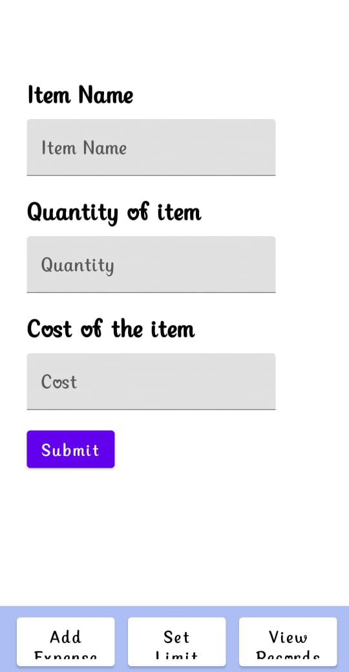
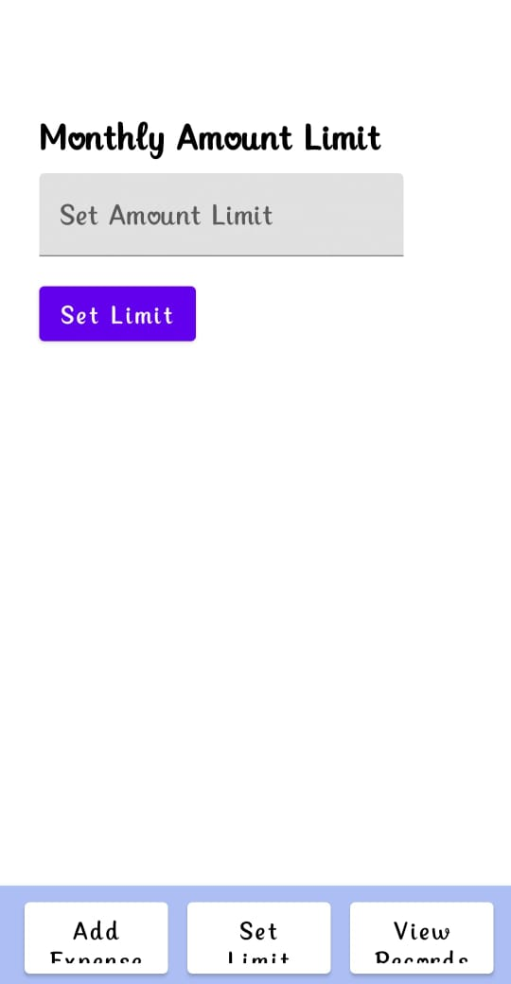
Step:3
Step:4

Slide 16

Step:5

Slide 17




Advantages of Money Matters
Financial Security
Provides peace of mind and stability.
Freedom and Choice
Enables pursuing goals and aspirations.
Wealth Accumulation
Allows for long-term investment and wealth building.

Slide 18

Disadvantages of Money Matters
Stress and Anxiety
Financial concerns can weigh heavily on mental health.
Limited Resources
Financial constraints can hinder opportunities and choices.
Debt and Interest
Borrowing can lead to debt cycles and high interest payments.

Slide 19


Application of Money Matters
Daily Life
Major Purchases
Managing expenses, saving for everyday needs, and making informed purchases.
Financing a home, car, or education through loans and mortgages.

Slide 20


